Slide 1
National Strategy for Advancing Mathematics Pathways for Student Success
Key features of the first draft
David May
AMPSS Project Director

Slide 2
The AMPSS Vision
All students desiring public postsecondary education will have options to receive the rigorous mathematics instruction that is most relevant to their chosen programs of study, whether begun at a community college or 4-year institution and regardless of their level of preparation; there will be seamless transfer of mathematics credits from 2-year to 4-year institutions contributing to greater student course and degree completion.
Notes:
OPTIONAL

Slide 3
Outline for this session
Goals
Integration with other efforts
Theory of Change
Action plan
An invitation
Q&A

Slide 4
The Goal of a long-term Strategy
To build a network of state efforts around the country to modernize math pathways at national scale.
In 40 states after five years:
Entry-level math courses exist and are:
rigorous and credit-bearing,
transferrable and applicable to majors across the state;
All students are enrolled in the right pathway for their program of study;
Accelerated remediation gets students through college-level math in one year or less.
Notes:
Responding to the national need the AMPSS partners came together to advance a vision for
students have the opportunity to enroll in a set of rigorous, entry-level, credit-bearing mathematics courses that are transferable and applicable to specific programs of study across 2- and 4-year institutions in the state.
all students are enrolled in the appropriate math pathway.
all students who need it are provided with accelerated or co-requisite remediation so that they can succeed in the appropriate college-level, credit-bearing math course within one year of matriculation.

Slide 5
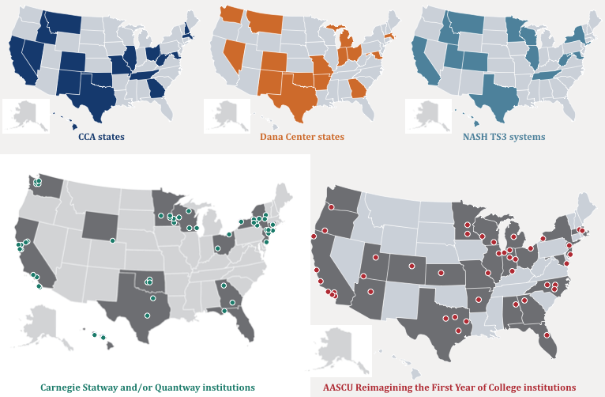
Evidence of promise
Notes:
Why we think we can do this.
This slide shows two things to some extent:
SOME of the places where work on math pathways has been happening (esp. CCA, Dana, Carnegie that have provided most of the assistance to states and institutions in this regard), and
SOME of the places where AMPSS partners have deep connections (with institutions and states AND with other organizations. Obviously there are other AMPSS partners and other groups that are a part of the extensive network that we’re forming, including all of you!)
Note: CCA will soon have(or already has?) some results from an institutional survey and from interviews with people at the state level in states that are scaling math pathways. Perhaps Bruce will share some new information with us.
Speaking of new data: (NEXT SLIDE)

Slide 6
Evidence, continued
Example: Carnegie’s Quantway and Statway
Who: Community college students in remedial math
College-level math completion within one year:
Increased from 6% to 48% with the introduction of Statway.
Two-year degree completion rates:
About 40% higher for Quantway students compared with all students at the same colleges.
Transfer rates to 4-year colleges:
About 40% higher for Quantway and Statway students compared with all students at the same colleges.
Notes:
This is from a brand-new report.
We managed to get these results into our strategy document right before we sent it to you.

Slide 7
Evidence, continued
Success rates can be tripled or better.
Data from CCA, the Dana Center, Carnegie, and others show that success rates in gateway mathematics increase from 20% to 60% or higher with redesign of remedial pathways.
The impact is at least as great for underrepresented groups.
In Tennessee’s co-requisite remediation effort, passage rates for college-level math went up four times, but for minority students it went up six times.

Slide 8
Integration with other efforts
Math pathways redesign must closely integrate with, or actually include at its core, these other aspects of undergraduate education:
Transfer and applicability
Remediation and developmental mathematics
Placement and advising
Guided Pathways and other “pathways”-type efforts
Teaching and learning
Alignment and partnership with K-12

Slide 9
AMPSS’ Theory of Change
Institutions’ and states’ efforts go through these phases:
Building awareness
Mobilizing
Creating enabling conditions
Institutional implementation
Connecting key stakeholders | Identifying issues | Designing math pathways | Enroll students in pathways
Deciding to act | Creating a vision | Building policy and procedural supports | Revise advising and placement
Forming a state team | Organizing and planning | Align pathways with majors | Support faculty, registrar, advisors
Notes:
More detail is in the handout – see Table 1.
OF COURSE state efforts don’t always fit cleanly into these approaches – that some institutions might already be in 4, as phases 2-3 are getting underway to attempt coherence across institutions in a state
This attempts to capture what all of you on the ground can and must do. In a moment I’ll discuss how AMPSS can help you in each phase.

Slide 10
Action plan for AMPSS
AMPSS partners intend to assist states in these ways:
Building awareness
Mobilizing
Creating enabling conditions
Institutional implementation
Broad publicity and engagement | Direct support to state teams (consultants, resources, etc.)
Connecting key stakeholders | Focused networking of states (by issue, geography, etc.)
Helping form a state team | Continued engagement with key players to keep them motivated
National coordination and monitoring of progress
Notes:
MORE DETAILS on this is on the handout, Table 2.
I do want to highlight the direct support to states, because that will be the most intensive piece. SEE NEXT SLIDE

Slide 11
Direct Support to States: Structure
Structure of support:
RFPs and selection of states
Lead Collaborator organization
Trained consultant
Coordination across states
Notes:
The direct support AMPSS will provide to states is built on what our partners have been doing, but with new collaborative work to design how we do it.

Slide 12
Direct Support to States: Kinds of support
Nature of support:
Technical assistance in all aspects of redesign and implementation, including:
Visioning, mobilizing, forming teams
Design of math pathways
Policy
Data collection and use for decision making
Institutional implementation and scale-up
Practitioner’s Guide and other common resources

Slide 13
Potential Impact of a National effort
Just looking at students in remedial mathematics:
1.3 million (in 2010)
Tripling their success rate in gateway math means:
500,000 more students each year
Postsecondary attainment?
Modifiers of the number above:
Gateway math completion ≠ college completion⬊
Shorter time to gateway completion will help⬈
Transfer rates are also apparently higher⬈
Non-remedial students would also benefit ⬈
Notes:
AFTER this slide:
So I think once this national strategy gets up and running, in a few years we should see AT LEAST half a million more students completing college who wouldn’t have otherwise. And over a 4-year period, for example, that would be another TWO MILLION students, disproportionately from underrepresented groups.

Slide 14
An Invitation
We need your help to ensure that this strategy is:
complete,
workable,
builds on what’s already underway, and
is likely to achieve the objectives we all have for student success.
Do you see yourselves, your institutions, states, and initiatives in this strategy?
What would you need to help your state move through the phases of our approach, and how would you get it?

