Slide 1

Modernizing Math Pathways
To Improve Degree Completion for
All Students
The what,
the why, and
the how
David May
Project Director
Advancing Mathematics
Pathways for Student Success

Slide 2
Objectives
Understand the case for math pathways including national trends
See math pathways as a part of completion generally
Understand the AMPSS partnership and the state math task force process
Understand roles at different levels: institutional and cross-institutional (state or regional)
Identify next steps to take to initiate work in institution, state, or region

Slide 3
Opening Exercise
What do you hope undergraduate students will get from their mathematics education?
Notes:
At each table, introduce yourselves and answer: “What do you hope students will get from their mathematics education?”
One person at each table report back to full group.
Say that we often hear: preparation for major, for career, AND for life in general – being an informed and literate citizen.

Slide 4
Outline for this session
The case for modernizing math pathways
National trends and the AMPSS coalition
How to modernize math pathways
Notes:
Each of these will include steps each institution can take to make progress on math pathways.

Slide 5
The case for modernizing math pathways
It’s about college completion

Slide 6
U.S. Future Requires Addressing
The Chasm in Education Success
Among U.S. 24-year-olds:
In the top
economic quartile,
In the bottom
economic quartile,
80% hold a 4-year college degree
10% hold a 4-year college degree

Slide 7
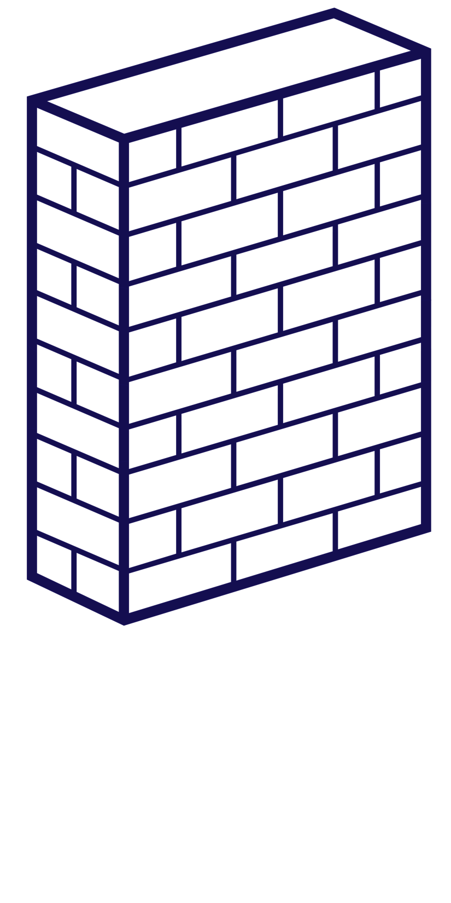



Math is the biggest academic hurdle to degree completion
Gateway
math
Notes:
The Department of Education found that the three college courses with the highest failure rates are mathematics courses.

Slide 8
the Biggest culprit: College Algebra
More than one million students take
College Algebra each year.
D, F, W:
45%
Nearly half withdraw, fail, or get a D.
A, B, C: 55%
Sources: Burdman, P. (2015). “Degrees of Freedom: Diversifying Math Requirements for College Readiness and Graduation.” Ganter, S. L., & Haver, W. E. (Eds.). (2011). Partner discipline recommendations for introductory college mathematics and the implications for college algebra.

Slide 9
Not just a course, but a pathway
Student success (or lack of it) depends on what they do before and after their gateway math course.
Before:
High school
Placement and advising
Remedial/developmental math
Gateway math
After:
Majors
Programs
Careers
Life in general

Slide 10
Remediation and developmental math
Developmental math enrollments are huge.
¼
2-year institutions
4-year institutions
⅔
Source: U.S. Department of Education (2009).
Notes:
The most common pathway into gateway math is remedial or developmental math.

Slide 11
developmental Math Students don’t advance
Remedial math students
15% pass college-level math
30% take college-level math
Source: The Charles A. Dana Center at The University of Texas at Austin (2015).
Notes:
More remediation means LOWER completion rates in gateway math and LOWER completion rates overall.

Slide 12
Not getting the math they need
College Algebra is intended to prepare students for Calculus.
Of students who take Algebra…
Student enrollments in different majors
Require
Calculus
…only 10% take Calculus 1
Do not
require Calculus
Sources: Small (2002), Dunbar (2005), Burdman (2015), Chen & Soldner (2013).
Notes:
ON THE LEFT: Yes, that’s just students who take College Algebra, not those who pass it. And “take Calculus 1” means whether it’s required or not.
Gateway math should prepare students for their major and career, BUT:
College Algebra has the wrong content for most students.
Algebra: its purpose is to prepare students for Calculus, but fewer than 10% take Calculus
Most majors don’t require Calculus – similar numbers for 2-year and 4-year institutions.

Slide 13
College Algebra doesn’t work for STEM majors, either
“The broad audience in College Algebra makes it challenging to organize this important course as a true stepping stone to Calculus.”
Source: The University System of Georgia Mathematics Task Force (2013).

Slide 14
Transfer and Applicability
About one third of students transfer at least once.
Many of these students’ math credits don’t transfer.
  And if they do, the credits don’t apply to their specific major or program of study.
Notes:
Ask: How many of your students are transfers?

Slide 15
The solution: modernized math pathways connected to majors
Many are developing multiple pathways like these:
Statistical reasoning
Social sciences
Quantitative reasoning, math methods, or math modeling
Humanities and fine arts
Algebra and Calculus
STEM and business
Notes:
Introduce concept of meta majors.
Some have created other pathways, for nurses, teachers, etc.

Slide 16
Example: Quantitative Reasoning
Quantitative reasoning, math methods, or math modeling
Humanities and fine arts
MATH 1001 Quantitative Reasoning
Logic
    Negations, Quantifiers, Conditional Statements, Converses
    Inductive and Deductive Reasoning, Valid Arguments
Basic Probability
Data Analysis
    Basic Descriptive Statistics (Mean, Median, Mode, Standard Deviation)
    Correlation, Causality, and Inferences
    Interpreting Graphical Displays
    Sampling and Randomness
Modeling from Data
    Function Concepts (Definition, Notation)
    Scatter Plots
    Linear Models and Regression Lines
    Quadratic Models
    Exponential Models
Source: University System of Georgia, Quantitative Reasoning Course Description draft (2013).

Slide 17
How these math pathways are helping
Before:
Better placement
Accelerated remediation
More support
Gateway math:
Different, relevant courses for different majors
After:
More success in all majors, programs, careers, and life
Notes:
You saw some significant positive results from Tristan Denley yesterday – Tennessee’s co-requisite remediation reforms have transformed the math pathways for many students.

Slide 18
National trends and the ampss coalition
What’s developing around the country

Slide 19
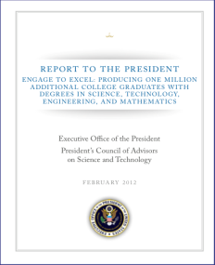

Increased national attention
College completion
Importance of mathematics
  High failure rates in mathematics are a primary barrier to college completion.
Sources: National Research Council, 2013; President’s Council of Advisors on Science and Technology, 2012.
Notes:
“The mathematical sciences include far more than numbers—they deal with geometrical figures, logical patterns, networks, randomness, and predictions from incomplete data, to name only a few topics.
And the mathematical sciences are part of almost every aspect of everyday life.”
—National Research Council. (2013). The Mathematical Sciences in 2025.

Slide 20
Mathematics Leaders Take Notice
“Unfortunately, there is often a serious mismatch between the original rationale for a college algebra requirement and the actual needs of students who take the course.
“A critically important task for mathematical sciences departments at institutions with college algebra requirements is to clarify the rationale for requirements, determine the needs of students, and ensure that the department’s courses are aligned with these findings.”
—Mathematics Association of America,
Committee on the Undergraduate Program in Mathematics

Slide 21
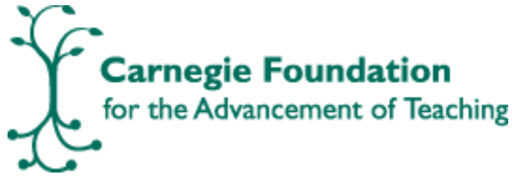





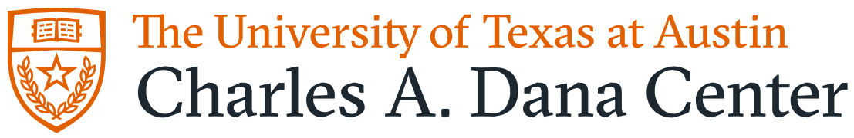
A new partnership
Over the last year or so, several organizations have come together to address the issue of math pathways:
Many of them have already been doing work in this arena.
Education organizations | Math professional societies | University and college associations
Conference Board of
Mathematical Sciences
Notes:
We realized there is an unprecedented opportunity for us to multiply our impact by working together.

Slide 22
Not a new initiative
College completion
Math pathways
Transfer
Remediation
Notes:
AMPSS is looking to supply or feed other student success initiatives (degree completion, transfer, etc. – not just pathways) with the math portions of them.
A close partnership is developing to achieve this, among AMPSS partners and others.
We’re talking to AACC, CCRC, AtD, ECS, others.

Slide 23
The AMPSS coalition and its GOALs
In 40 states after five years:
Entry-level math courses exist and are:
  rigorous and credit-bearing,
  transferrable and applicable to majors across the state;
Most students are enrolled in the right pathway for their program of study;
Accelerated remediation gets students through college-level math in one year or less.
Notes:
Responding to the national need the AMPSS partners came together to advance a vision for
students have the opportunity to enroll in a set of rigorous, entry-level, credit-bearing mathematics courses that are transferable and applicable (to specific programs of study) across 2- and 4-year institutions in the state.
most students are actually enrolled in the appropriate math pathway – i.e., the one that corresponds to their chosen program of study.
all students who need it are provided with accelerated or co-requisite remediation so that they can succeed in the appropriate college-level, credit-bearing math course within one year of matriculation. The pathway each student takes must be aligned with their chosen program of study to the extent they know it.
We got a PLANNING GRANT from Lumina to create a national strategy to do this.

Slide 24
AMPSS’ National Strategy
➔ A national strategy and implementation plan for institutions, states, and organizations ⬅
Broad engagement
    Focused networking
        Direct support for statewide planning and design
            Direct support for institutional implementation

Slide 25
How to modernize math pathways
Getting started on a complex process

Slide 26
AMPSS’ Theory of Change
Institutions’ and states’ efforts go through these phases:
Building awareness
Mobilizing
Creating enabling conditions
Institutional implementation
Connecting key stakeholders | Identifying issues | Designing math pathways | Enroll students in pathways
Deciding to act | Creating a vision | Building policy and procedural supports | Revise advising and placement
Forming a state team | Organizing and planning | Align pathways with majors | Support faculty, registrar, advisors
Notes:
Individuals network
Statewide teams from key institutions
Statewide teams working with institutions
institutions

Slide 27
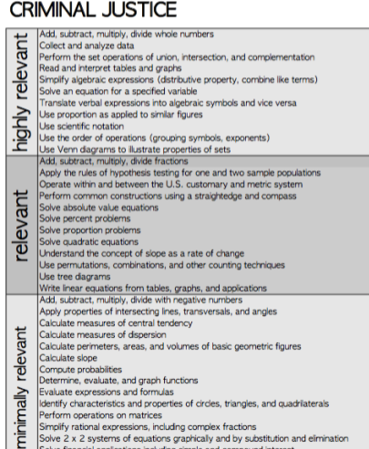
How to redesign math pathways
Get the right people together
  Mathematicians
  Administrators
  Faculty from other disciplines
Determine what math students need
Source: The Charles A. Dana Center and Ivy Tech Community College, “What Students Need to Know” (2013).
Notes:
In your institution as well as in your state.
This example (“Criminal Justice”) is one of many from the “What Students Need to Know” report from Indiana community colleges.

Slide 28
How to redesign math pathways (continued)
Explore options and make decisions about how best to meet those needs
To the extent possible, take a statewide approach to redesigning math pathways
  This will help address transfer and applicability
After implementing, continue paying attention to:
  Advising and support
  Enrollments (are the right students taking the right courses?)
  Data that indicate any impacts of the changes
Notes:
In your institution as well as in your state.

Slide 29
Questions to address
What support would you need to engage in this work?
How does math pathways align with your state’s degree completion efforts and goals? (Think about connecting with those people.)
Who else should you connect with, across your state and at your own institution? (e.g., math leaders, administrators, 2-year colleges)
Notes:
This is for after lunch.

Slide 30
Next steps
Find the key people who need to be involved and bring them together (AMPSS can help you with this)
Start determining what your most pressing needs are related to math pathways
Look out for upcoming AMPSS orientations, meeting sessions, and (later this year, perhaps) larger-scale activities and opportunities for support.
  We might be able to send someone to address an appropriate group from your state.
Review the excellent resources at the Dana Center’s Math Pathways website: dcmathpathways.org

